Slide 1
Plant-Based No Oil Caesar Salad and Dairy Free Parmesan Croutons
Kelly LeGros Strickler – RST 1200-002

Slide 2
The ingredients: Kalamata olives, Dijon mustard, dairy free parmesan cheese, water, navy beans, garlic, lemon and zest

Slide 3
Croutons: slice baguette into rounds, heat oven to 350 degrees Fahrenheit, top with dairy free parmesan cheese and bake for 10-15 minutes until toasted.

Slide 4
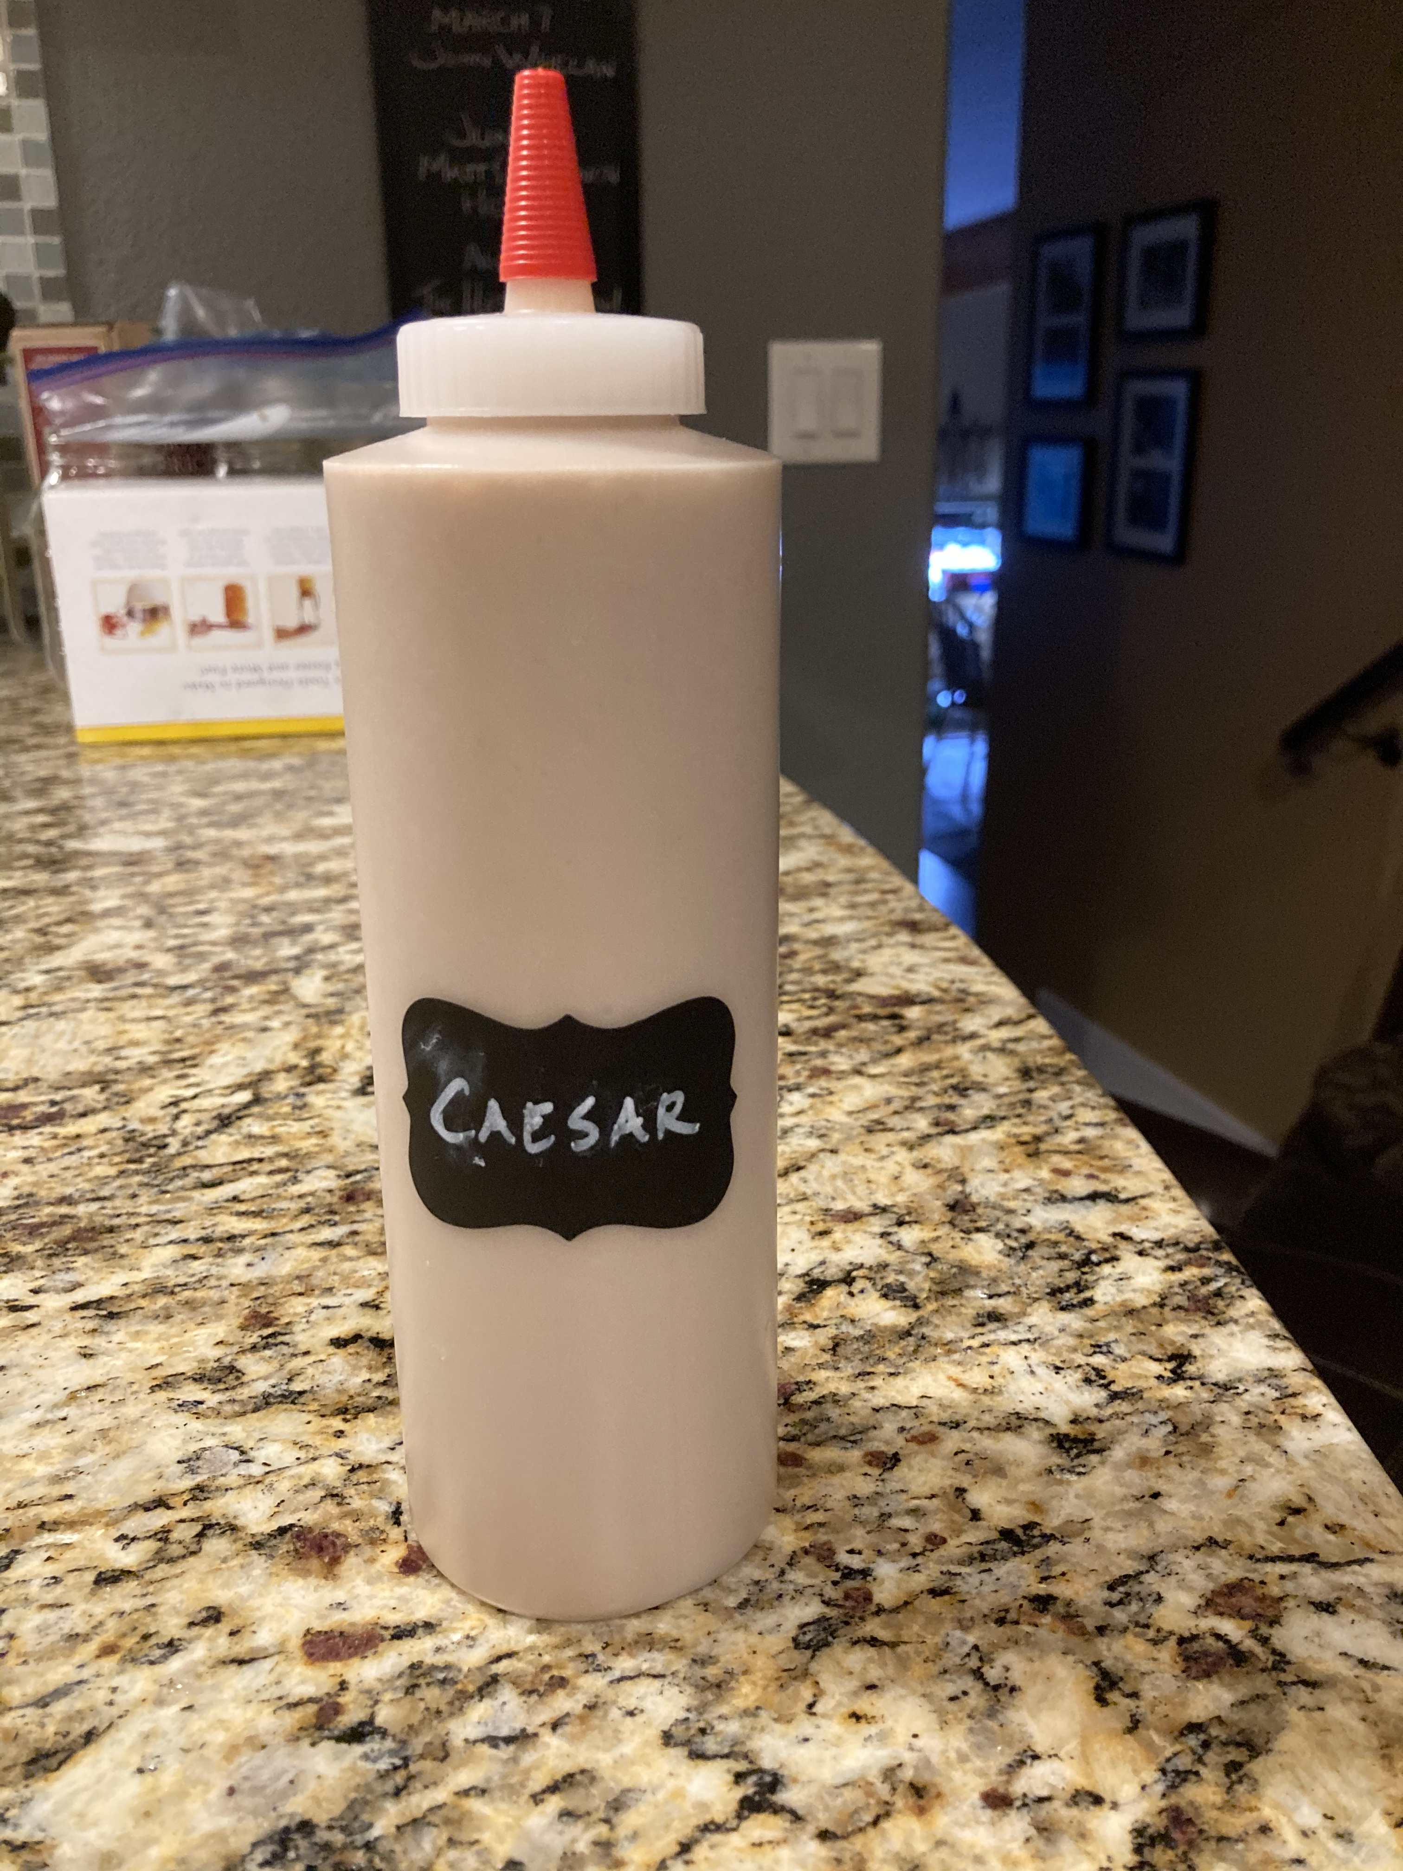
Blend 1 cup navy beans, 10 Kalamata olives, 2 tablespoons Dijon mustard, 2 cloves garlic, juice of 1 lemon and its zest. Add water until you get desired consistency.

Slide 5
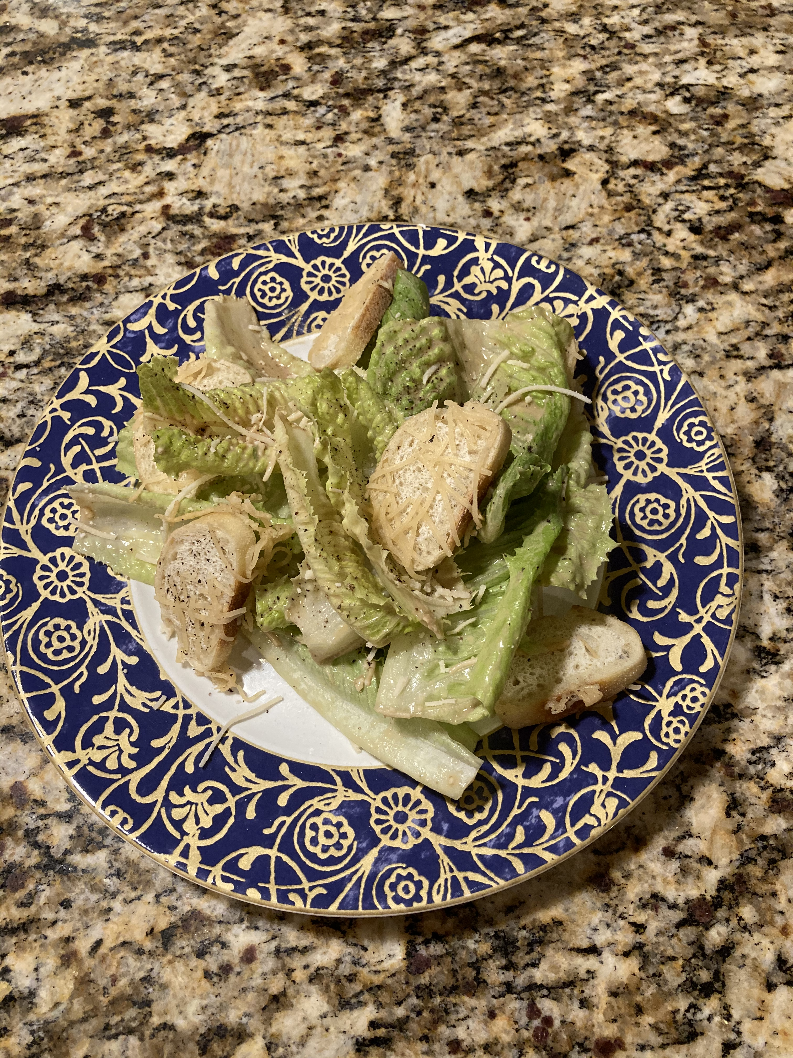
Toss heart of romaine lettuce with Caesar dressing and dairy free parmesan cheese. Serve with cheesy croutons.

